Slide 1

Session Initiation Protocol
RENAISSANCE SOFTLABS PVT. LTD.
www.renintech.com

Slide 2
Transactions
SIP is a transactional protocol
Sequence of SIP messages exchanged
Transaction consists of one request and all responses to that request
SIP entities that have notion of transactions are called stateful
Notes:
43 possible headers

Slide 3
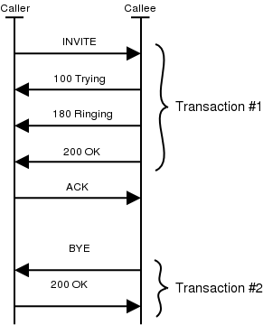
Transactions
Notes:
43 possible headers

Slide 4
Dialogs
Transactions in a Session should be related
A Dialog represents a peer-to-peer SIP relationship between two user agents
A Dialog persists for some time
Dialogs facilitate proper sequencing and routing of messages between SIP endpoints.
Notes:
43 possible headers

Slide 5
Dialogs
Dialogs are identified using Call-ID, From tag, and To tag
CSeq header field is used to order messages in a Dialog
CSeq number identifies a transaction within a dialog
Dialog can also be said as a sequence of transactions
Notes:
43 possible headers

Slide 6
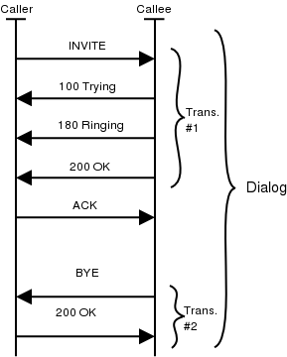
Dialogs
Notes:
43 possible headers

Slide 7
Dialogs
Some messages establish a dialog and some do not
INVITE message establishes a dialog
Because BYE request follows it which will tear down the session established by the INVITE
This BYE is sent within the dialog established by the INVITE
Notes:
43 possible headers

Slide 8
Dialog Identifiers
Consist of three parts, Call-Id, From tag, and To tag
Call-ID is so called call identifier
From tag is generated by the caller and it uniquely identifies the dialog in the caller's user agent
To tag is generated by a callee and it uniquely identifies the dialog in the callee's user agent
Notes:
43 possible headers

Slide 9
Presence and Instant Messaging
SIP for Instant Messaging and Presence Leveraging Extensions (SIMPLE)
  Several vendors who intend to implement SIMPLE
  Provides for presence and buddy lists
  Instant Messaging in the enterprise
  Telephony enabled user lists
Notes:
43 possible headers

Slide 10

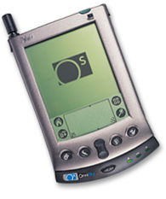
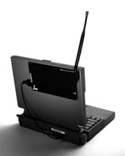
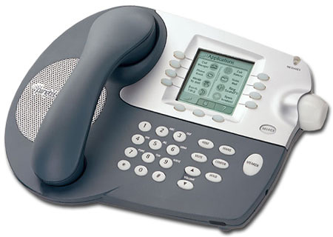
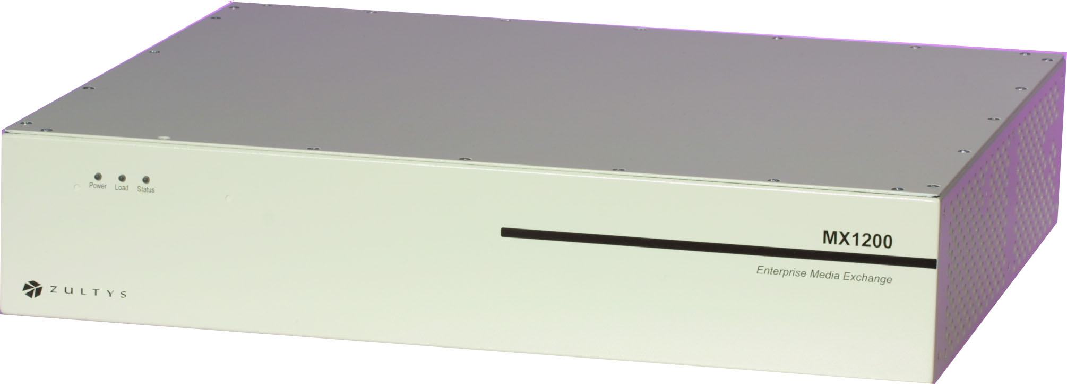
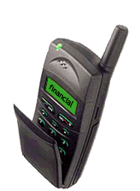
Presence and Instant Messaging
NETWORK PROXY
PRESENCE USER AGENTS
SUBSCRIBE
SUBSCRIBE
REGISTER
LOCAL PROXY
SUBSCRIBE
NOTIFY
NOTIFY
NOTIFY
NOTIFY
PRESENTITY
PROXY, REGISTRAR PRESENCE AGENT
WATCHER
PRESENTITY
Notes:
43 possible headers

Slide 11
SIP for Presence: Subscribe and Notify
WATCHER
Presentity
200 OK presentity->watcher
SIP/2.0 202 Accepted
Via: SIP/2.0/UDP watcherhost.example.com:5060
From: User
To: Resource
Call-ID: 3248543@watcherhost.example.com
Cseq: 1 SUBSCRIBE
Expires: 600
Content-Type: application/xpidf+xml
Content-Length: 351
NOTIFY Presentity->watcher
NOTIFY sip:user@watcherhost.example.com SIP/2.0
Via: SIP/2.0/UDP pres.example.com:5060
From: Resource
To: User
Call-ID: 3248543@watcherhost.example.com
CSeq: 1 NOTIFY
Content-Type: application/xpidf+xml
Content-Length: 352
Subscribe
202 Accepted
Notify
200 OK
SUBSCRIBE watcher -presentity
SUBSCRIBE sip:presentity@pres.example.com SIP/2.0
Via: SIP/2.0/UDP watcherhost.example.com:5060
From: User
To: Resource
Call-ID: 3248543@watcherhost.example.com
CSeq : 1 SUBSCRIBE
Expires: 600
Accept: application/xpidf+xml, text/lpidf
Contact: sip:user@watcherhost.example.com
Notes:
43 possible headers

Slide 12
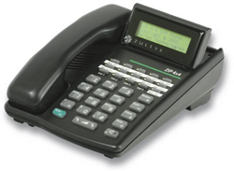

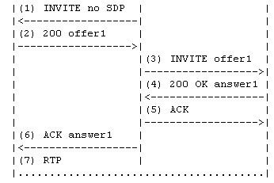
3rd Party Call Controller (Basic)
User A SIP Phone
Controller
Agent B PC
Notes:
43 possible headers

Slide 13
3rd Party Call Controller (Click-to-Dial)
User PC
User B SIP Phone
Controller
Agent A PC
HTTP GET
200 OK
INVITE no SDP
200 SDP A1
ACK SDP held
INVITE no SDP
200 SDP U1
INVITE SDP U1
200 SDP A2
ACK SDP A2
ACK
RTP
Notes:
43 possible headers

